Slide 1

Machine Learning Module 3 project Car Insurance Cold Calling
LaShanni Butler
Flatiron School
5/28/19

Slide 2

Agenda
Overview
Machine Learning Workflow
Background
Problem Statement
Machine Learning models
Conclusion

Slide 3
Overview
What is Machine Learning?
ML works on the development of computer programs that can access data and use it to automatically learn and improve from experience. (I.e. – it’s a technique that uses statistics to help machines learn from past data).
Examples include:
Amazon Echo (Alexa) functions off of ML, and develops its accuracy based off of the user(s) interactions
Google search algorithms
Email spam filters
Sources:
Simplilearn: What Is Machine Learning: https://www.youtube.com/watch?v=HgBpFaATdoA&list=PLEiEAq2VkUULYYgj13YHUWmRePqiu8Ddy&index=3

Slide 4
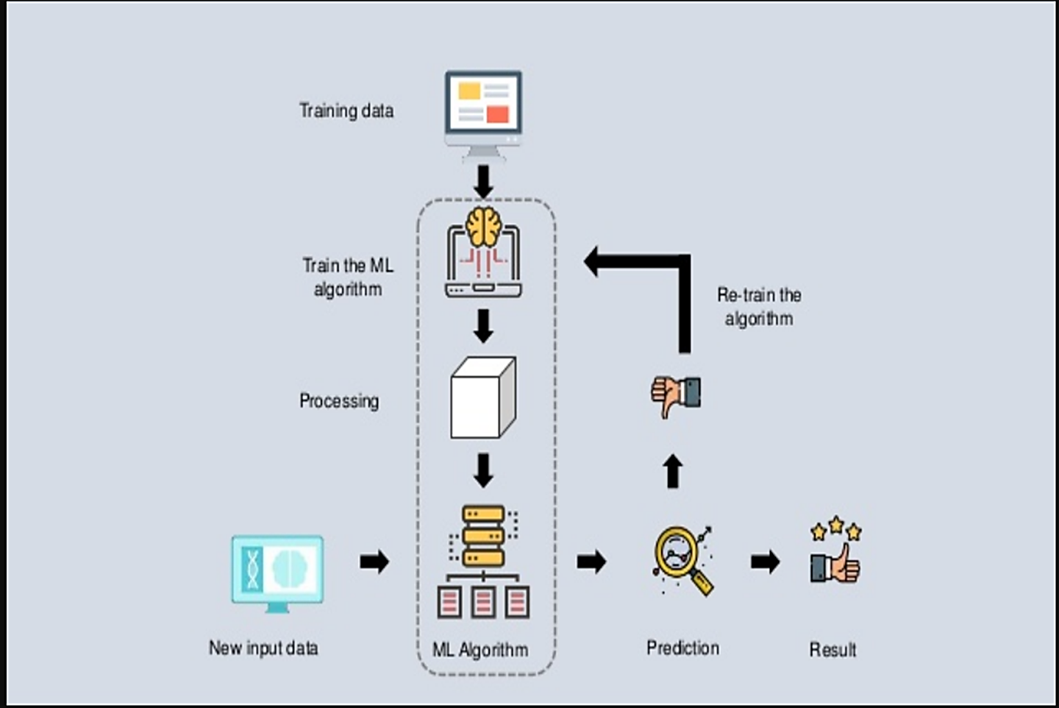
Machine Learning workflow
Sources: Simplilearn: What Is Machine Learning: https://www.youtube.com/watch?v=HgBpFaATdoA&list=PLEiEAq2VkUULYYgj13YHUWmRePqiu8Ddy&index=3

Slide 5
Background
Types of Machine Learning Models:
Supervised: Is a method used to enable machines to classify and predict objects, problems or situations based on labeled data fed to the machine. Data is labeled, direct feedback is given and machine predicts output.
Examples: Logistic Regression, Decision Trees, K-Nearest Neighbors, Random Forest
Unsupervised: Systems are able to identify hidden data patterns from input given. Data is unlabeled, no feedback is given and machine finds hidden structure in data.
Examples: K-means Clustering, Partial Least Squares, Fuzzy Means, Principal Component Analysis
Reinforcement: Systems are given no training and is rewarded or punished based on its last action. It helps increase efficiency.
Sources:
Simpliearn: Machine Learning vs Deep Learning vs Artificial Intelligence: https://www.youtube.com/watch?v=9dFhZFUkzuQ&list=PLEiEAq2VkUULYYgj13YHUWmRePqiu8Ddy&index=4
Notes:
Within supervised learning, there are 2 types: Classification (which we’ll focus on) and Regression.
Classification is the type of Supervised Learning in which labelled data can use, and this data is used to make predictions in a non-continuous form. The output of the information is not always continuous, and the graph is non-linear. In the classification technique, the algorithm learns from the data input given to it and then uses this learning to classify new observation.

Slide 6

Problem Statement
The dataset: Contains consumer information from a company conducting cold calling. The dataset contains general info (i.e. – age, education, job, etc.) and cold calling info (i.e. – communication, last contact, previous contact attempts, etc.).
The Ask: The client would like to know the most important factor that determines cold calling success. So we’ll use predictive models (i.e. – Machine Learning techniques) to see which factor(s) are successful.
Sources:
Kaggle dataset: https://www.kaggle.com/kondla/carinsurance

Slide 7
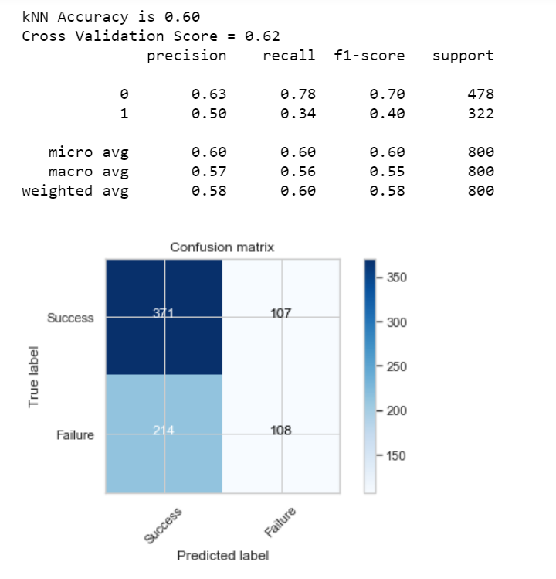
K-Nearest Neighbors
KNN is generally used to predict categorical values based on the nearest datapoints of interests
Confusion matrix: a summary of prediction results on a classification problem. The number of correct and incorrect predictions are summarized with count values and broken down by each class.
Notes:
KNN algorithm is one of the most straightforward algorithms in classification, and it is one of the most used learning algorithms. A majority vote of an object is classified by its neighbors, with the purpose being assigned to the class most common among its k nearest neighbors.

Slide 8
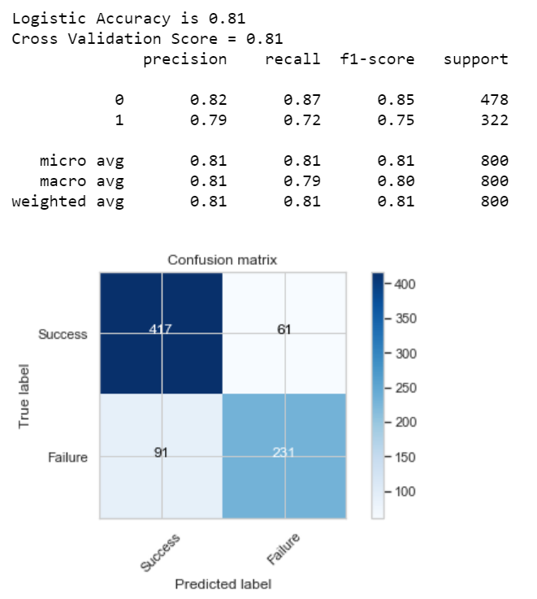
Logistic Regression
The simplest classification algorithm used for binary or multiclassification problems (datasets where y = 0 or 1, where 1 denotes the default class).
Notes:
Logistic regression predictions are discrete values (whether a student passed/failed) after applying a transformation function.
Logistic regression is best suited for binary classification (datasets where y = 0 or 1, where 1 denotes the default class).
Example: In predicting whether an event will occur or not, the event that it occurs is classified as 1. In predicting whether a person will be sick or not, the sick instances are denoted as 1). It is named after the transformation function used in it, called the logistic function h(x)= 1/ (1 + e^x), which is an S-shaped curve.

Slide 9
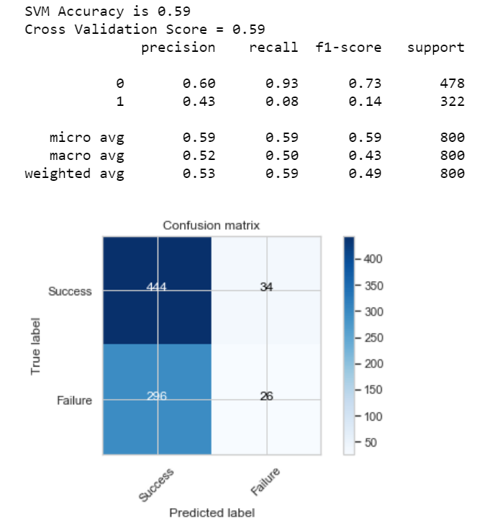
Support Vector Machine (SVM)
Is widely used classification algorithm. SVM creates a separation line which divides the classes in the best possible manner. Ex - dog or cat, disease or no disease.
Notes:
A Support Vector Machine is a type of Classifier, in which a discriminative classifier formally defined by a separating hyperplane. The algorithm outputs an optimal hyperplane which categorizes new examples. In two dimensional space, this hyperplane is a line dividing a plane into two parts wherein each class lay on either side.

Slide 10
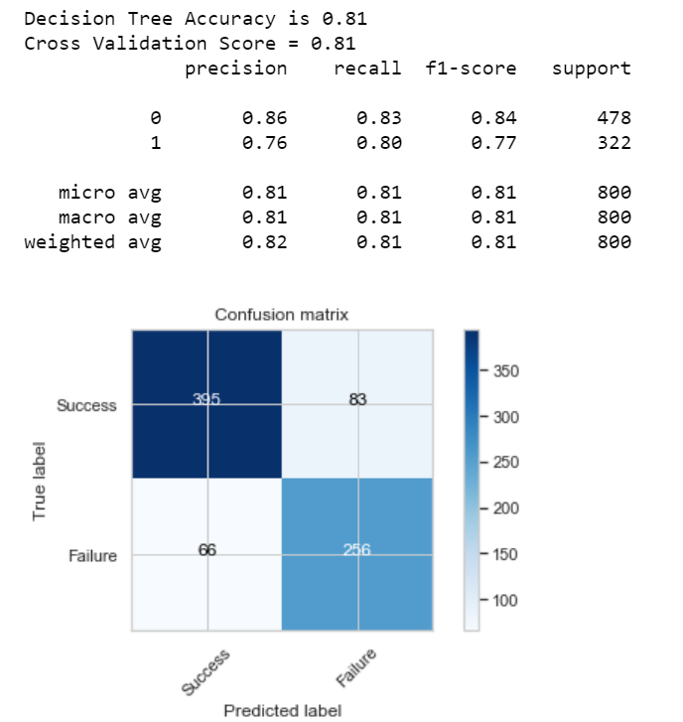
Decision Tree
Is an inverted tree shaped algorithm used to determine a course of action. Each tree branch represents a possible decision
Notes:
Decision tree makes classification models in the form of a tree structure. An associated decision tree incrementally developed and at the same time It breaks down a large data-set into smaller subsets. The final result is a tree with decision nodes and leaf nodes. A decision node (e.g., Root) has two or more branches. Leaf node represents a classification or decision. The first decision node in a tree which corresponds to the best predictor called root node. Decision trees can handle both categorical and numerical data.

Slide 11
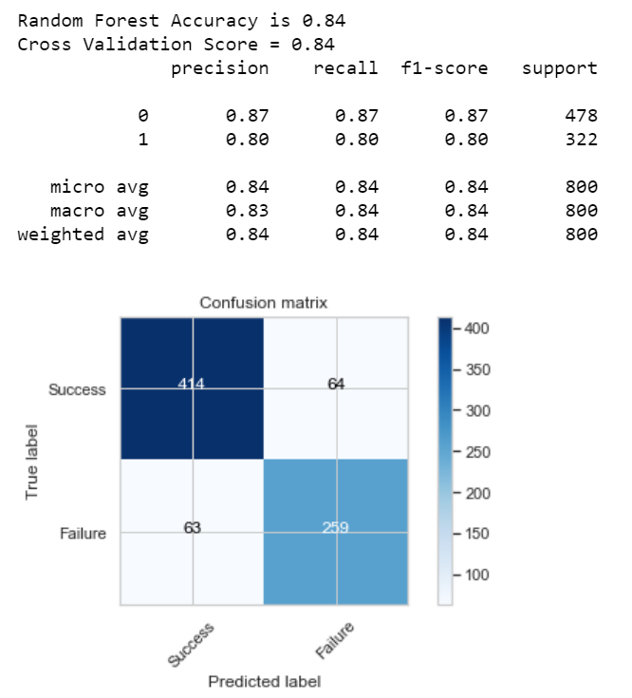
Random Forest
Similar to Decision Tree, but multiple trees are used. Each "tree" observation is classified. Usually increased the accuracy when DT is used as an algorithm.
Notes:
Random Forest is a supervised learning algorithm. It creates a forest and makes it somehow casual. The wood it builds is an ensemble of Decision Trees, it most of the time the decision tree algorithm trained with the “bagging” method, which is a combination of learning models increases the overall result.

Slide 12
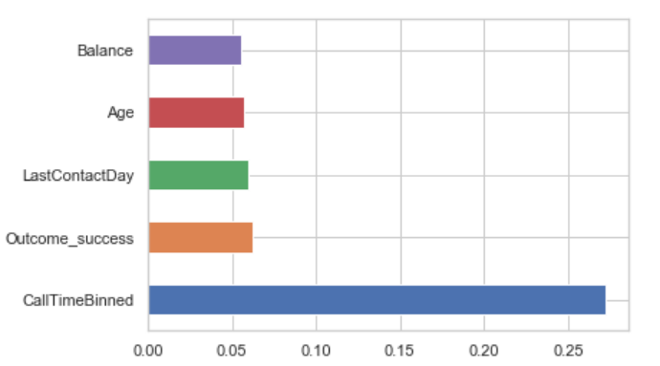
Conclusions
Based on the predictive modeling, Random Forest had the highest percentage of 84%, and a cross validation score of 84%.
Interestingly, Call Time had the most effect on customers who were cold called. Last Contact Day also showed would be more likely to purchase car insurance.

Slide 13
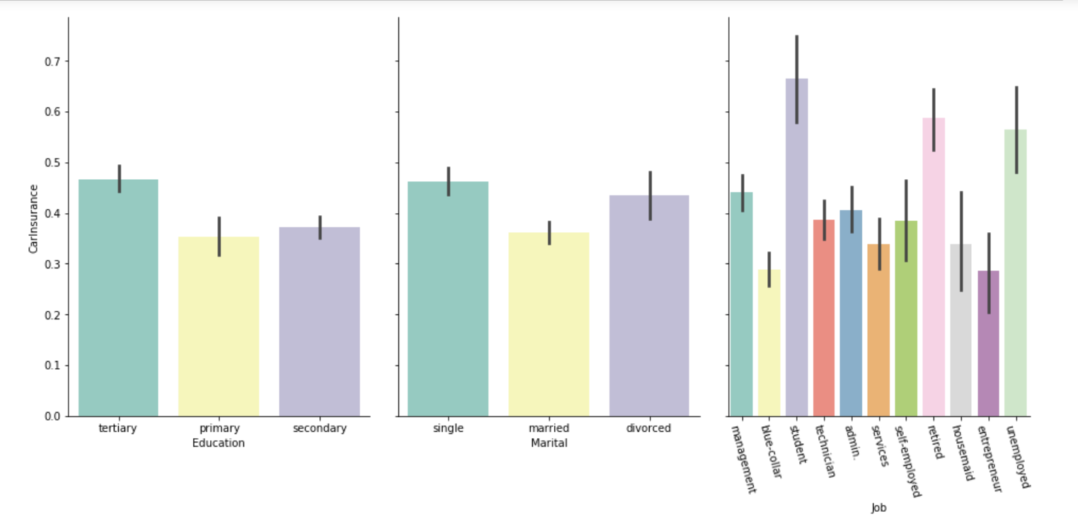
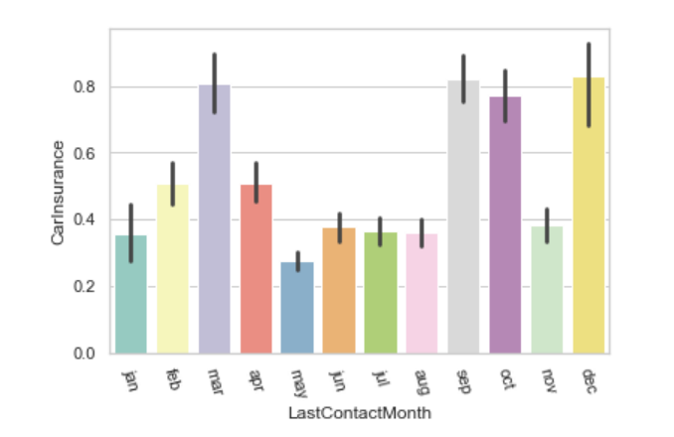
Conclusions
Potential customers with tertiary (advanced) educations are more likely to purchase insurance
Single people are more likely to purchase insurance
Students, retired and unemployed people are purchasing the most car insurance polices
Many people buy insurance in March, September, October and December

Slide 14
Questions?
Link to recorded presentation: https://drive.google.com/file/d/19z0aYThNQTfa1epXunNkVkAjBTcQlF7F/view?usp=sharing

